Slide 1


数据通信和网络
Sim-LAN
陈薇羽 12210460

Slide 2

01
VLAN
02
Router
03
Switch table update
Functions

Slide 3

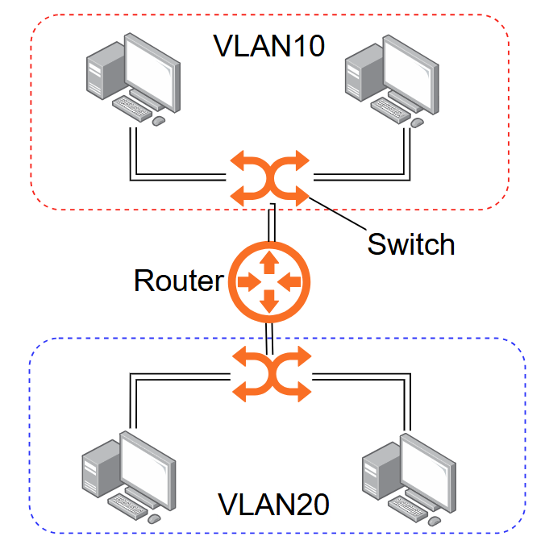
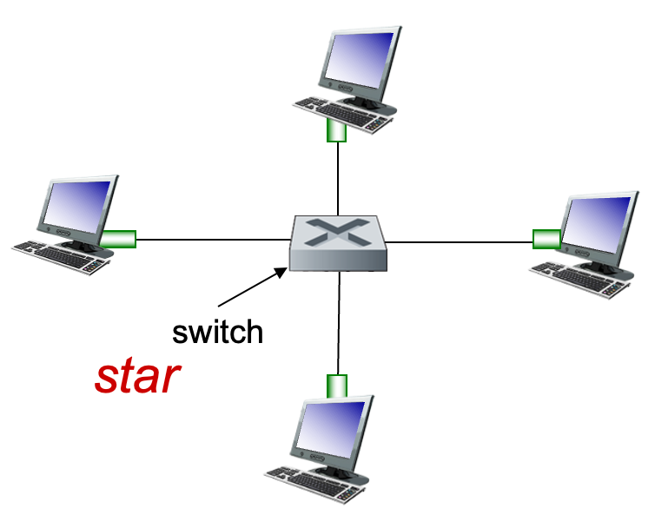
Sim-LAN Structure

Slide 4
